Slide 1
BIKE SHARING DEMAND
ANALYSIS DASHBOARD
Chart-Heavy Visual Analysis | 58,304 Total Rentals | 1,000 Records
58,304
53,383
4,921
17:00
1,000
TOTAL RENTALS
REGISTERED
CASUAL
PEAK HOUR
RECORDS

Slide 2
Key Performance Metrics
58,304
53,383
4,921
17:00
Total Rentals
Registered Users
Casual Users
Peak Hour
100% of dataset
91.6% of total
8.4% of total
6,169 rentals
58.3
249
976
24
Avg Rentals/Record
Max Hourly Rentals
Working Days
Holidays
per hourly record
single hour peak
97.6% of records
2.4% of records

Slide 3
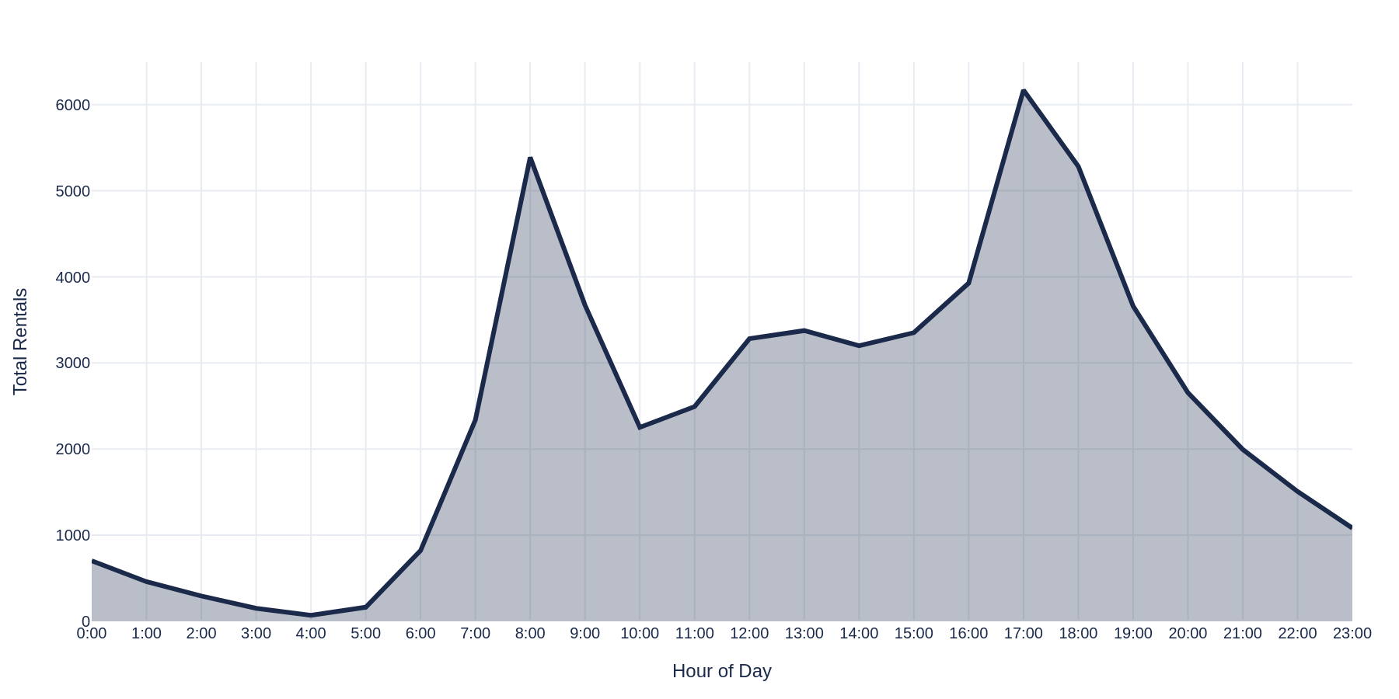
Hour vs Total Rentals
Peak at 17:00 with 6,169 rentals | Secondary peak at 08:00 with 5,388

Slide 4
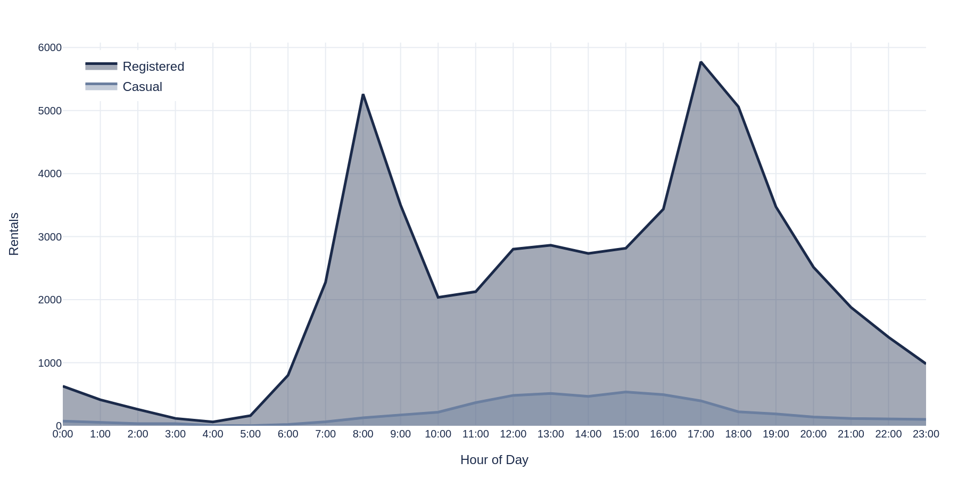
Hourly Rentals: Casual vs Registered Users
Registered users peak at commute hours | Casual users peak mid-afternoon

Slide 5
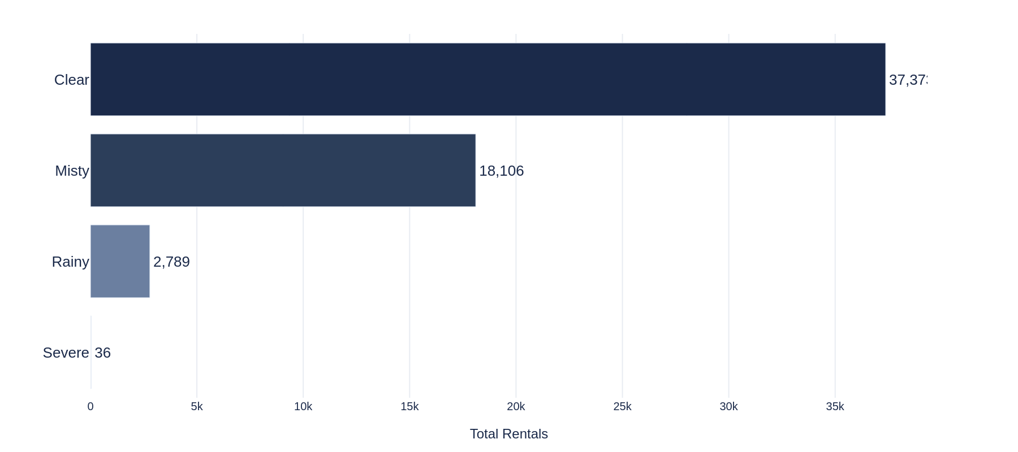
Rentals by Weather Condition
Clear weather drives 64.1% of all rentals | Severe weather nearly eliminates demand

Slide 6
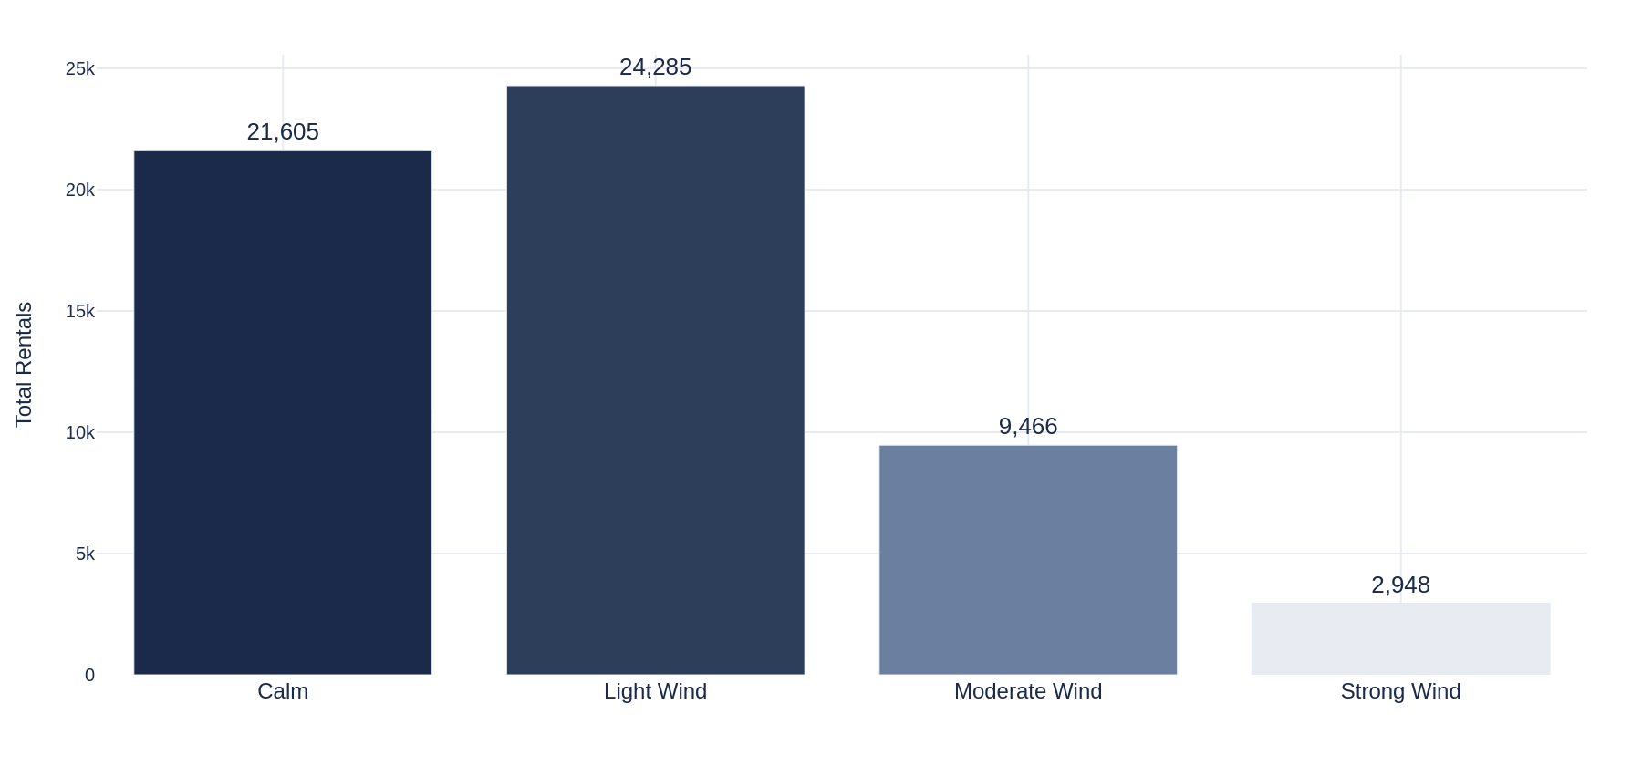
Wind Speed Category vs Rentals
Light wind optimal (41.7%) | Strong wind reduces demand by 88%

Slide 7
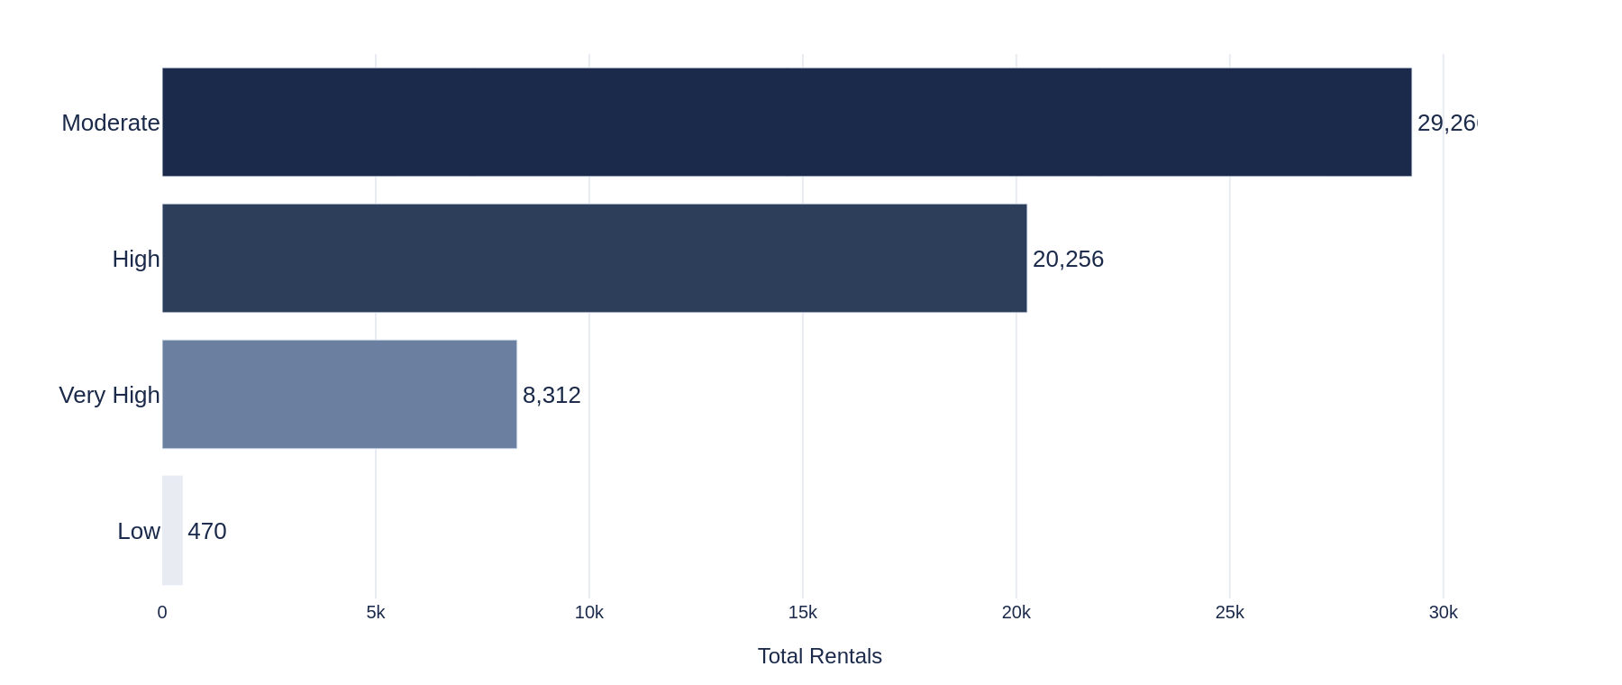
Humidity Category vs Rentals
Moderate humidity drives 50.2% of rentals | Low humidity = minimal activity

Slide 8
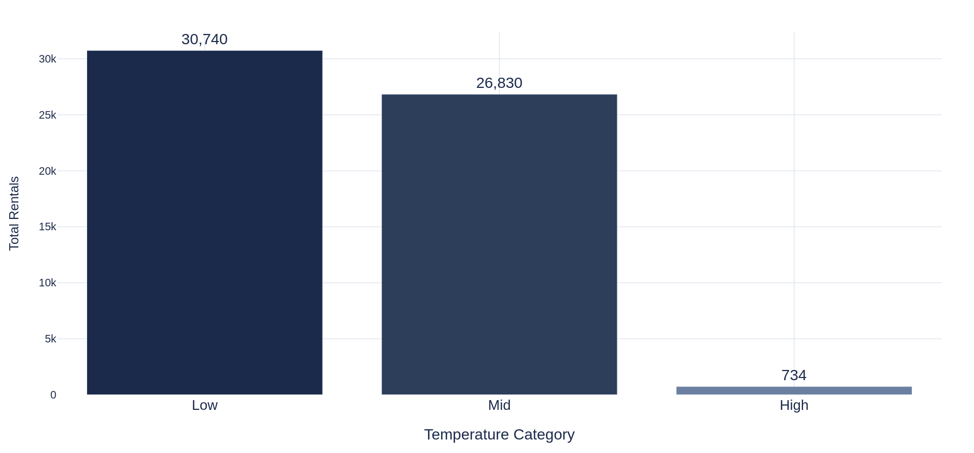
Rentals by Temperature Category
Low temperatures show highest volume (52.7%) | High temps nearly eliminate demand

Slide 9
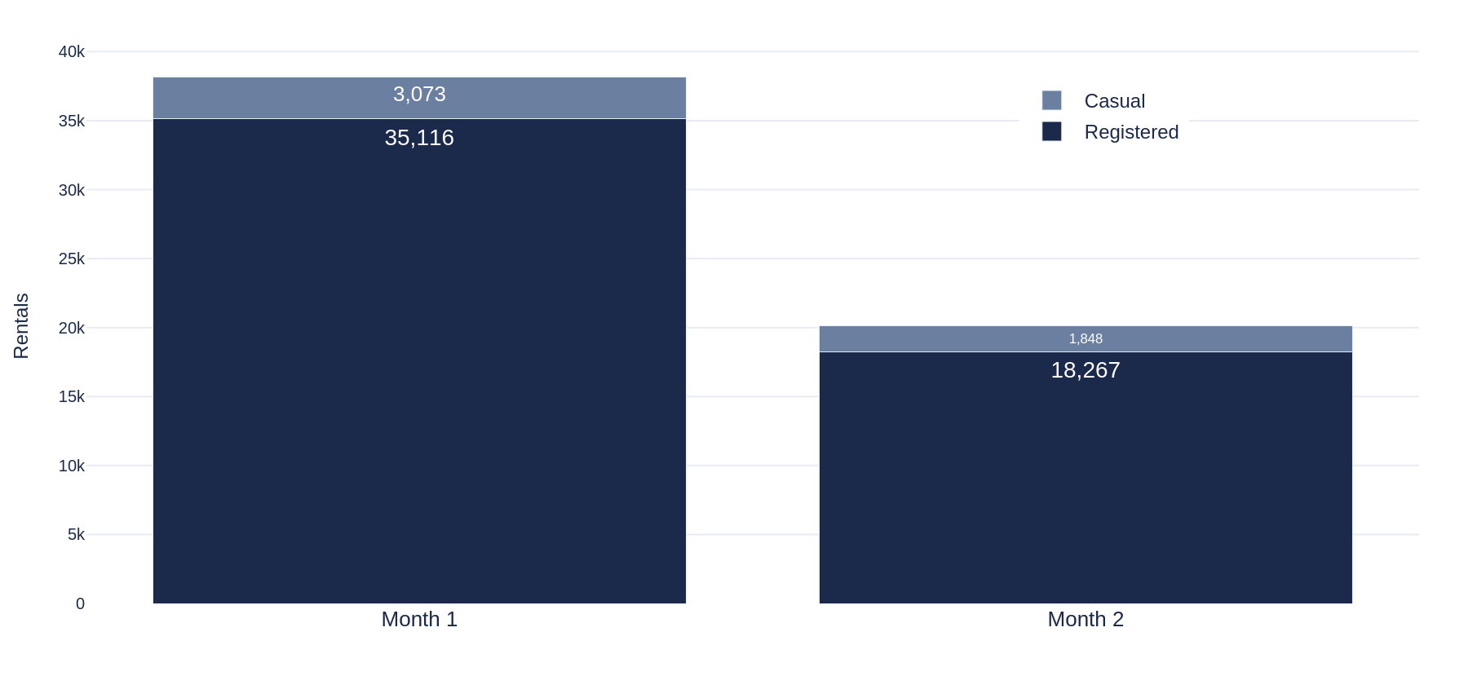
Monthly Casual vs Registered Users
Month 1: 38,189 total | Month 2: 20,115 total | -47.3% decline

Slide 10
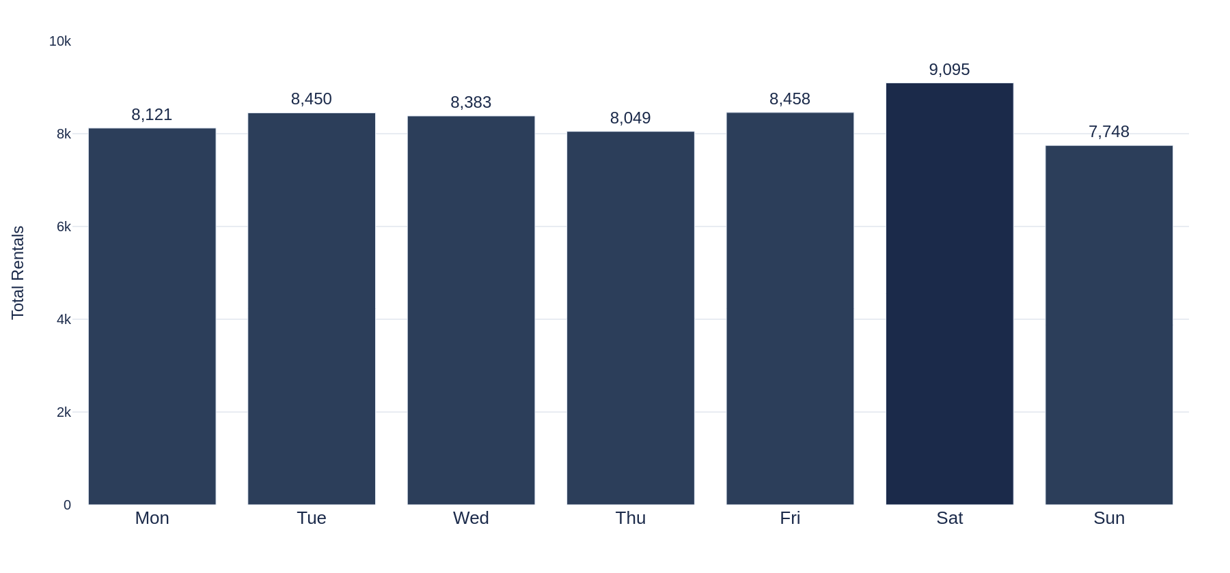
Rentals by Day of Week
Saturday is busiest (9,095) | Sunday has lowest demand (7,748)

Slide 11
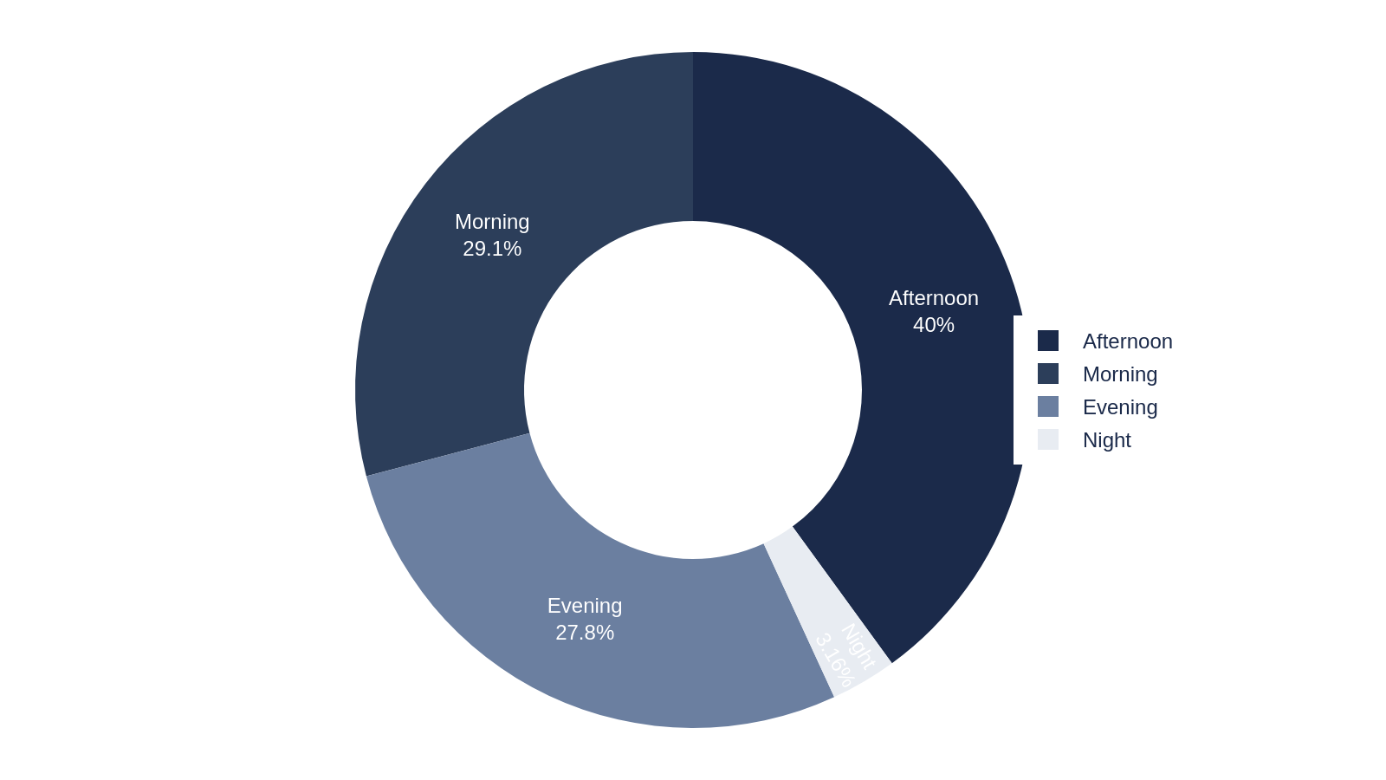
Rentals by Session of Day
Afternoon dominates with 40.0% | Night accounts for only 3.2%

Slide 12
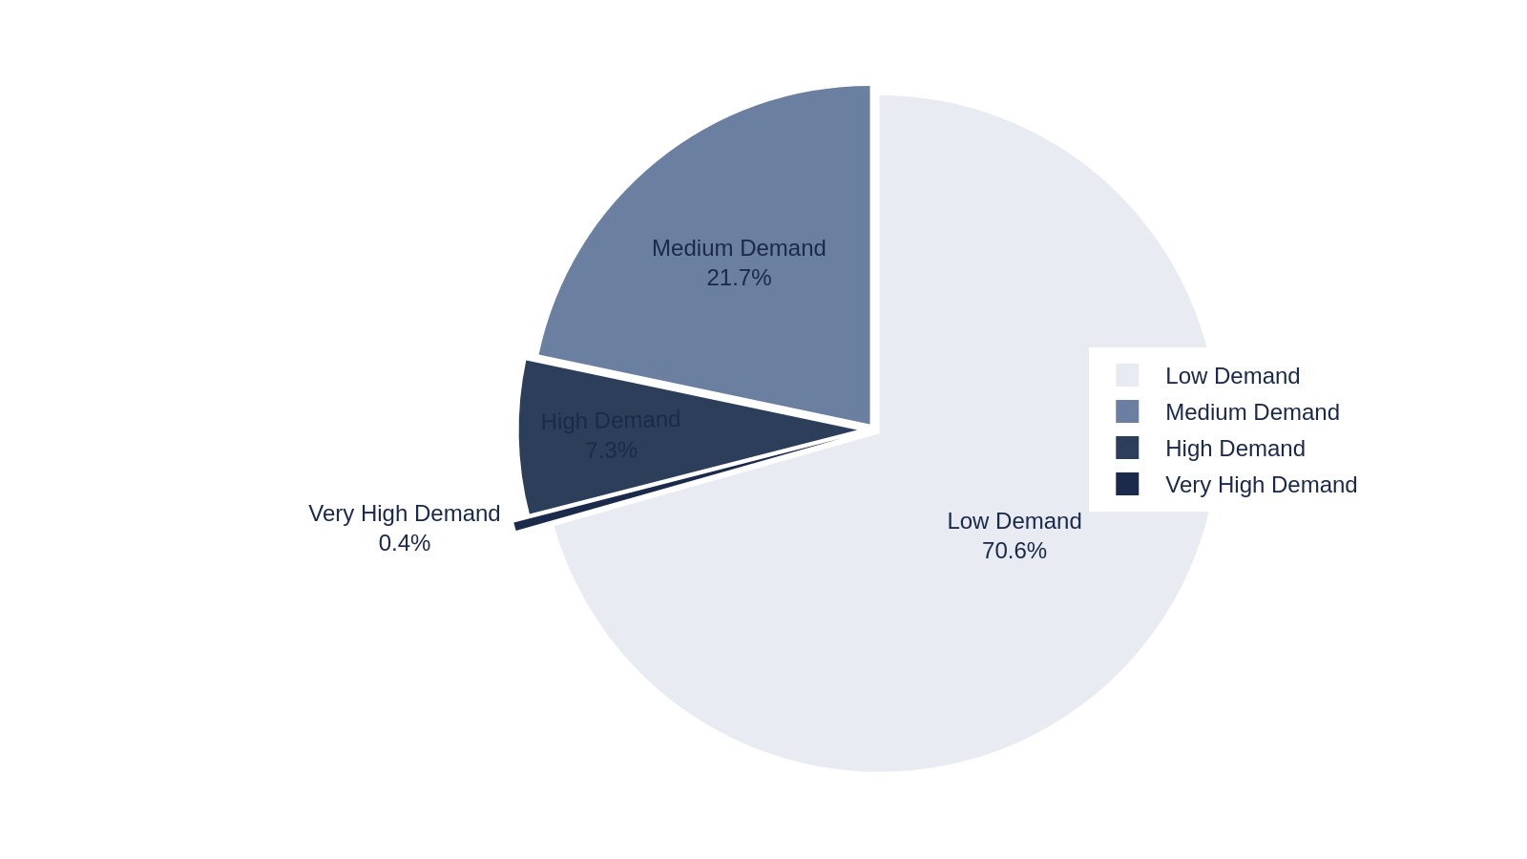
Rental Demand Category Distribution
Low demand: 706 records (70.6%) | Very High: only 4 records (0.4%)

Slide 13
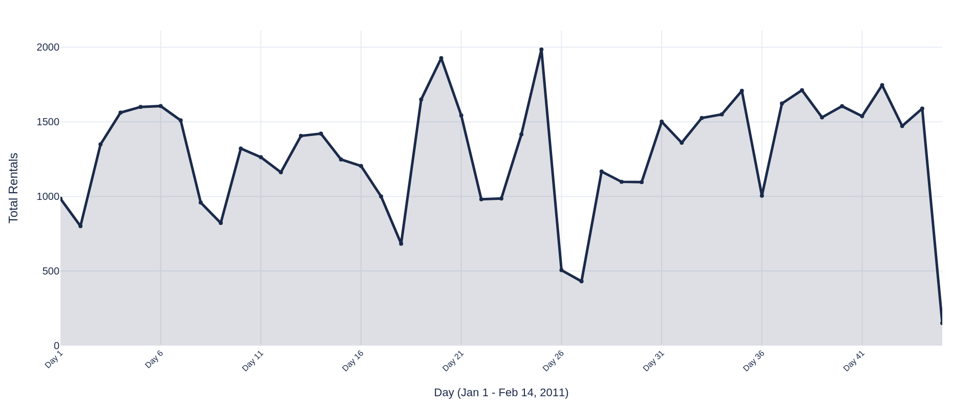
Daily Rental Trend (Jan 1 - Feb 14, 2011)
45 days of data | Peak: 1,985 (Day 25) | Low: 151 (Day 45)

Slide 14
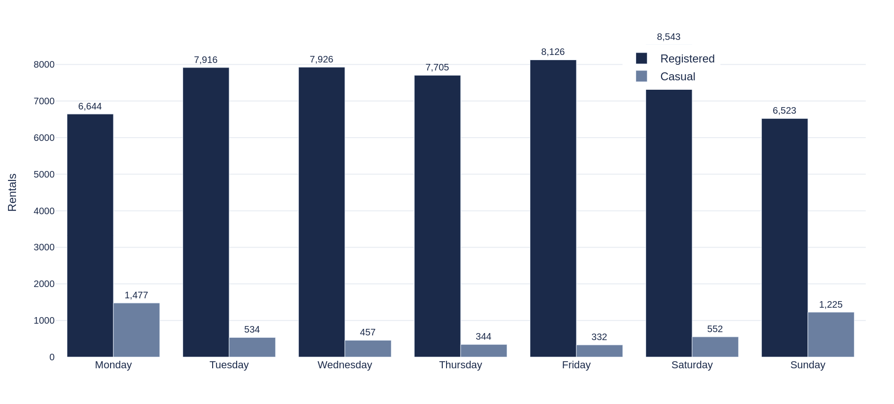
Day of Week: Casual vs Registered
Casual peaks on Monday (1,477) | Registered peaks on Saturday (8,543)

Slide 15
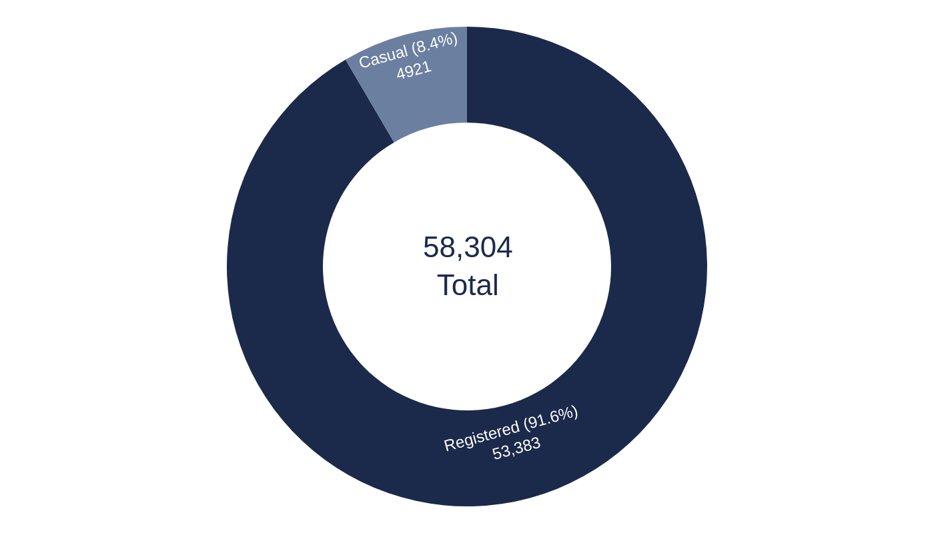
Key Insights
01
Peak hour 17:00 = 6,169 rentals (10.6% of total)
02
Registered users = 91.6% of all demand
03
Clear weather drives 64.1% of rentals
04
Saturday is busiest day (9,095 rentals)
05
Afternoon session accounts for 40% of all rentals
Data-driven decisions for optimized bike sharing operations

